Slide 1
Investments AI Circle
FOLLOW-UP
22 September 2025

Slide 2

Index
1) Recent updates in AI
2) Technical Analyst GPT
3) McKinsey: How AI could reshape the economics of Asset Management industry
4) Foundation Models for Time Series Analysis
5) Kronos: A Foundation Model for the Language of Financial Markets
6) 7 key lessons building AI-powered workflows
7) Takeaways

Slide 3


1.1) Mistral 7B-Instruct Now Accessible via JupyterHub in SAM
We now have access to Mistral 7B-Instruct-v0.2 directly through JupyterHub for testing purposes, enabling structured experimentation with generative AI inside SAM Head of IT approved environment.
Configurable workflows: Users can programmatically adjust parameters such as maximum tokens, temperature, system instructions, and prompts—facilitating systematic process automation.
Governance: Access is provided via. A Group-wide initiative is underway to develop an official LLM API.
Next steps: Users interested in leveraging this model should share their use cases and confirm GITF access requirements.
X
Why it matters: This deployment provides a practical, secure framework to test and scale AI-driven processes, marking the first step toward building AI agents, while preparing for the eventual adoption of the Group’s official LLM API.

Slide 4
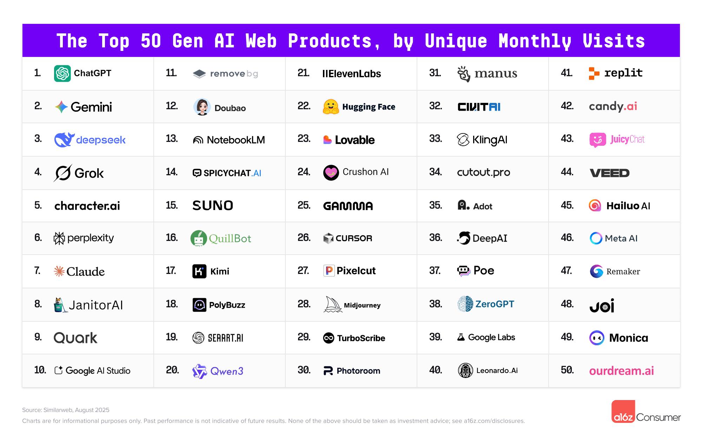
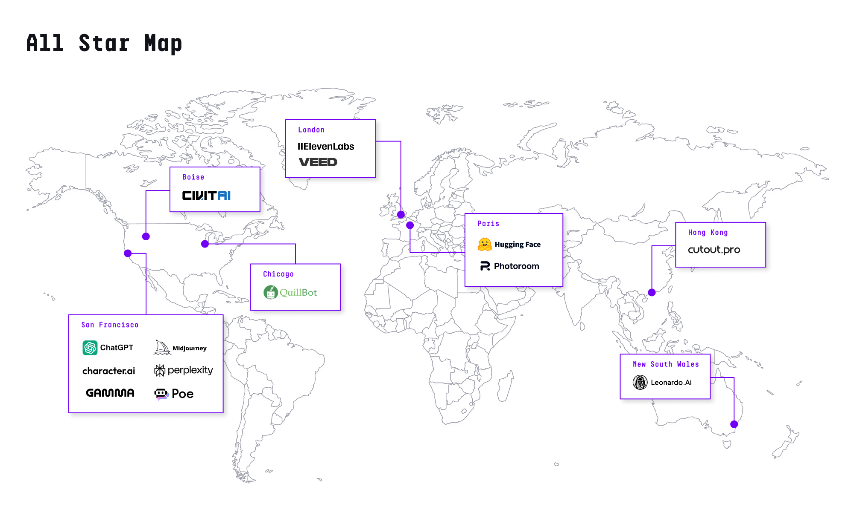
1.2) Most Used AI Applications
A16Z has released its annual report on the most used Artificial Intelligence applications.
Details
It can be viewed from the most visited or used, to those that have just launched. Few surprises, a market still heavily dominated by ChatGPT.
However, Google and NotebookLM are growing and recovering, China is entering with its own apps, and programming remains a highly representative use case of this era.
Why it matters: When people say there are “many AI applications” (which there are), we should focus more on the ones that are actually being used. It’s a common process of “explosion” and “concentration.” Many emerge, few will survive.
Links:
The Top 100 Gen AI Consumer Apps - 5th Edition | Andreessen Horowitz

Slide 5


1.3) Microsoft ends OpenAI exclusivity in Office, adds rival Anthropic
Anthropic announced that Claude can now generate and edit Excel, Word, PowerPoint, and PDFs directly within its app, moving beyond text responses to full document workflows.
Technical progress: Users can describe tasks, upload data, and receive completed files—covering spreadsheets, slide decks, and formatted reports.
Competitive edge: Internal Microsoft tests reportedly found Claude Sonnet 4 outperforming OpenAI in spreadsheet automation and visual design, fueling interest in integrating Anthropic models into Office 365.
Strategic positioning: Claude is evolving into a comprehensive workplace assistant, handling end-to-end document processes and competing at the core of enterprise productivity.
X
Why it matters: By embedding into everyday business tools, Claude highlights how AI assistants are shifting from conversation to execution—reshaping the future of office work.
Link:
Ars Technica

Slide 6
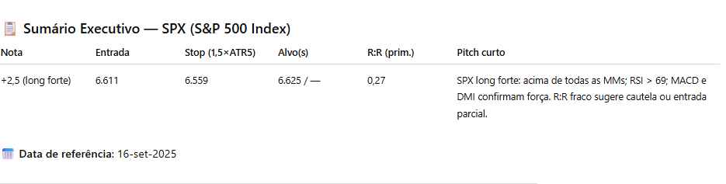


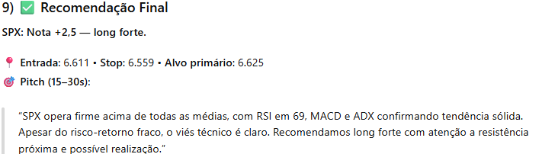
2) Technical Analyst GPT
What is:
A technical decision agent assigning position scores from –3 to +3;
Full pipeline: indicators → back-test → risk management → pattern recognition → score;
Works across equities, FX, fixed income, and commodities.
Benefits
Consistency & Scale: automated, disciplined coverage across multiple assets;
Statistical Rigor: walk-forward validation and Monte Carlo simulations ensure historical robustness;
Transparent Decision-Making: includes entry, stop, target, and rationale;
Tactical Management: score changes help trigger entry, hold, or exit actions;
Stop Monitoring: both technical and statistical stops are logged and tracked;
Potential for Continuous Improvement: scores archived and compared with future outcomes
Challenges
Parameter Sensitivity: tuning window lengths and weights can impact signal stability;
Regime Drift: market behavior shifts require periodic recalibration;
Explainability: translating multiple signals into a concise, committee-ready pitch;
Automation & Scalability: input is still manual — scaling to more assets remains a challenge.

Slide 7
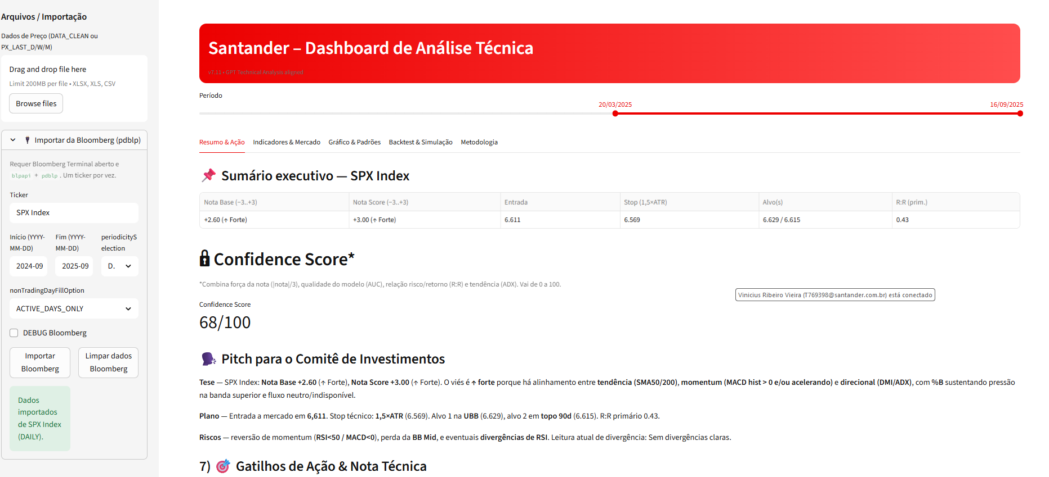
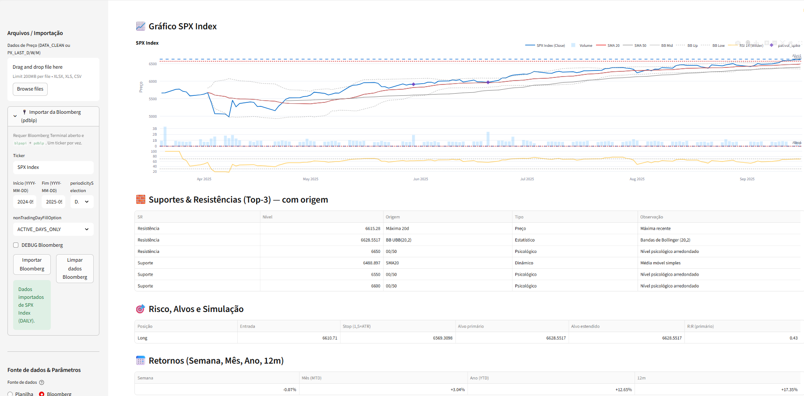
2) Technical Analyst GPT
Achievements so far:
Built a Streamlit dashboard using what we developed with GPT.
Established a direct link with Bloomberg, allowing asset-level analysis
Dashboard now performs almost the same tasks as the GPT, but in a more user-friendly and visual way.
Tool can be shared across regions, providing scalability.
Lower cost: doesn’t consume GPT tokens once deployed in Streamlit.
Next steps to evolve
Enable the dashboard to pull technical data directly from Bloomberg (currently only price and volume).
Improve code to import weekly and monthly data.
Enhance debugging and stability for larger codebases.
Continue refining backtesting and simulation capabilities.

Slide 8
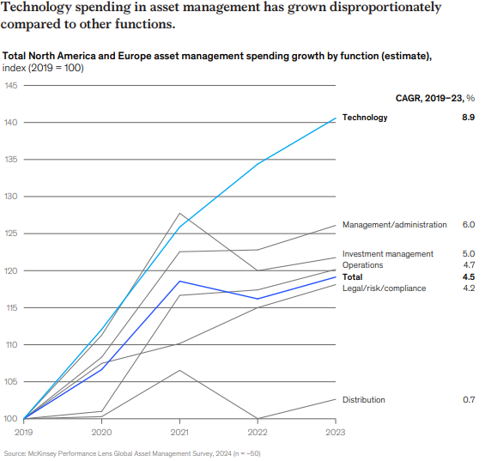
3) McKinsey: How AI could reshape the economics of Asset Management industry
Rising tech costs, shrinking margins
The asset management sector faces margin pressure due to the end of favorable tailwinds (low interest rates, stable growth) and rising technology costs without clear returns. Between 2019 and 2023, operating margins fell by three percentage points in North America and five in Europe, while technology spending grew nearly 9% annually, without significant productivity improvements.
Artificial intelligence emerges as a key lever to reverse this trend. McKinsey estimates it could generate efficiencies equivalent to 25–40% of a manager’s cost base. The highest-potential use cases include:
Distribution and marketing (personalization, virtual assistants, automated content generation).
Investment management (research assistants, portfolio construction and optimization, enhanced risk models).
Compliance and risk (automated monitoring, regulatory interpretation).
Internal technology (code copilots, system maintenance, IT incident management).

Slide 9
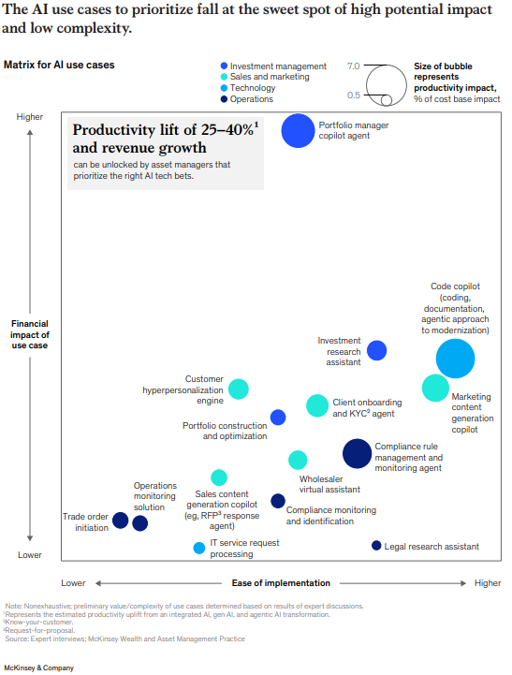
3) McKinsey: How AI could reshape the economics of Asset Management industry
Unlocking profitability with domain-wide AI transformation
The report stresses that benefits will only materialize through domain-wide redesigns, not isolated projects. It proposes six strategic pillars:
Domain-based transformation (rather than fragmented use cases).
Talent strategy and AI upskilling.
Operating models with centralized governance and decentralized execution.
Control of the technology roadmap and strategic use of vendors.
Unified data platforms and robust governance.
Change management and cultural adoption, supported by training and incentives.

Slide 10
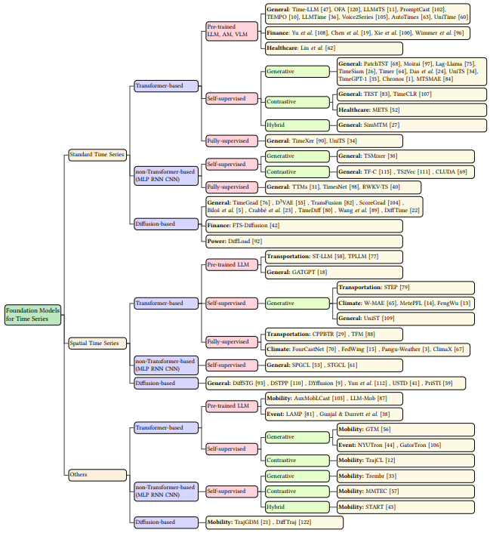
4) Foundation Models for Time Series Analysis: A Tutorial and Survey - Liang et al. (2024)
Taxonomy of TSFMs
(categorized according to data and methodologies)
This paper is a survey/tutorial on the state of the art of foundation models applied to time series (TSFMs).
Methodology-centric taxonomy that organizes TSFMs along four dimensions:
Data types: standard time series, spatial time series, trajectories, and event sequences
Transformer-based, non-Transformer (MLPs, RNNs, CNNs), and diffusion-based
Pre-training techniques: supervised, self-supervised (generative, contrastive, hybrid).
Adaptation strategies: fine-tuning, zero-shot, prompting, tokenization.
Summarizes representative models such as Lag-Llama, TimeGPT, Moirai, Chronos, TimesFM, highlighting their design choices and application domains.
Discusses applications across finance, healthcare, climate, transportation, and mobility, including multimodal approaches integrating text, audio, or images.
Open challenges:
Efficient handling of long sequences (Transformers’ quadratic cost).
Modeling distribution shifts and causal structures in time series.
Leveraging multimodal data for richer representations.
Preserving privacy in sensitive domains

Slide 11
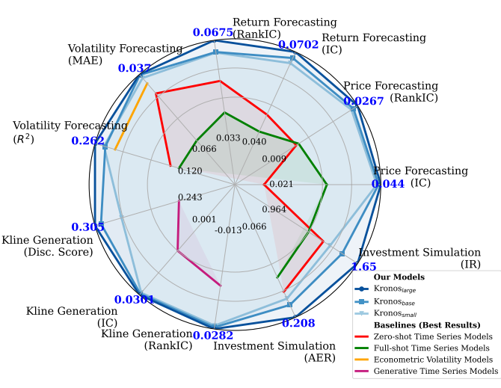
4) Kronos: A Foundation Model for the Language of Financial Markets - Shi et al. (2025)
This paper introduces Kronos, a foundation model designed specifically for financial time series based on candlestick data (K-line: OHLCVA).
Kronos positions itself as a robust and versatile foundation model for quantitative finance, outperforming both general-purpose TSFMs and traditional econometric/non-pre-trained models.
Kronos performance across several quantitative finance task
Proposes a specialized tokenizer that converts continuous financial data into hierarchical discrete tokens (coarse-to-fine), enabling multi-scale modeling of market dynamics.
Pre-trained autoregressively on 12 billion K-lines from 45 global markets, capturing both temporal and cross-asset dependencies.
Evaluated on multiple tasks central to quantitative finance:
Price and return forecasting: +93% RankIC improvement over the best existing TSFM.
Volatility forecasting: 9% lower MAE compared to econometric benchmarks.
Synthetic K-line generation: +22% fidelity improvement.
Investment simulation: achieved the highest Annualized Excess Return (AER) and Information Ratio (IR) compared to 25 baselines

Slide 12
5) 7 key lessons building AI-powered workflows
The article from Exponential View outlines seven key lessons from their experience building AI-powered workflows, along with a toolkit featuring over 50 tools they use. The central idea: integrate AI not as an add-on, but as a structural part of work and organizational culture.
The 5x Rule
If a task is repeated at least five times a month, it’s a candidate for automation.
Example: a system that automates expenses, invoices, and travel reports, saving hours of repetitive tasks.
LLMs as Foremen, Not Bricklayers
Use LLMs to define and structure tasks, not to execute them end-to-end.
Combine models with scripts, code, or deterministic tools for more reliable results.
Time Compression as an Emotional Challenge
AI reduces tasks from hours to minutes.
The challenge is not technical but psychological: learning to trust results that come “too fast” and resisting the urge to overcorrect.
Living Documentation
AI keeps documentation updated in real time (e.g., transcribed voice notes, automated summaries).
This improves onboarding, coordination, and debugging.
Modular Flows
It's better to break processes into small, autonomous modules.
This facilitates testing, debugging, and scalability.
Example: identifying potential partners → data enrichment → automated outreach drafting.
Humans Are Still the Core
AI enhances human work when it’s well-structured and documented.
The key is scaffolding: AI + well-guided humans → greater impact without losing quality or judgment.
Research + Prompting > Prompting Alone
Prompting is more powerful when combined with updated context (papers, repos, best practices).
Example: redesigning a RAG pipeline using recent techniques, moving from generic output to actionable architecture.

Slide 13
7) Takeaways (I)
General discussions
Mistral model now embedded in Jupiter Hub for internal testing; users can modify temperature, tokens, system instructions, and prompts.
A16Z published a list of the top 100 GenAI consumer apps, offering a good overview of mainstream tool usage and geographic distribution.
Ongoing effort to compile all GPT use cases within SAM Global Investments → Awaiting IT clearance to share full descriptions.
McKinsey Report: Real ROI only comes with full org-wide cultural and technical transformation.
Foundational Models: Taxonomy of models used in return/volatility forecasting and spotlight on Kronos, a foundational model with strong performance in time series prediction → Relevant to QIS teams.
Teams + ChatGPT: Structured Notes Bot (Mauro – Mexico): Microsoft Teams chatbot that parses market views from messages and structures options-based ideas.

Slide 14
7) Takeaways (II)
Technical Analyst GPT → Streamlit Dashboard
Original GPT-based assistant evolved into a fully functional Streamlit dashboard.
Key improvements:
No GPT API usage anymore → cost-saving
Bloomberg integration via Python package
Real-time technical analysis (RSI, MACD, Bollinger Bands, etc.) with asset selection
Graph plotting, candle pattern detection, and basic backtesting module
Limitations:
Bloomberg API can only retrieve price/volume, not precomputed indicators
Backtesting and simulations need enhancement
Future plans:
Expand to fixed income and commodities
Improve ranking, governance, and historical data handling.
Code sharing across regions is feasible (vs. data sharing, which is restricted)

Slide 15
Gracias
Thank you

